Slide 1
Integrated Review System
CSCI 5408 Data Management, warehousing & Analytics
Analysis on restaurant reviews
Hemanth Kurra (B00784050)
SriSaiChand Singamaneni (B00792835)

Slide 2




Overview
Problem Statement
In general, most people rely on online reviews for choosing restaurant
End up reading all the reviews or just see the star ratings

Slide 3

So, we aim to develop a system that can
Consolidate reviews from different sources
Analyse the reviews
Provide the integrated review

Slide 4
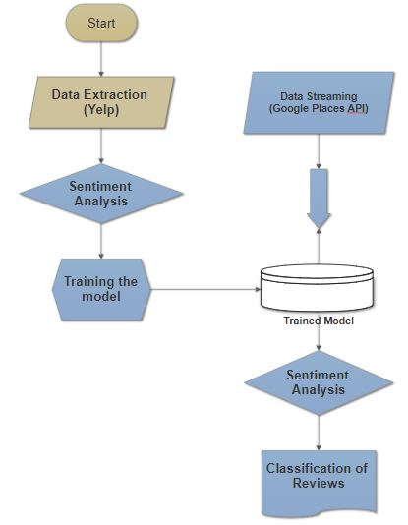
Work Flow

Slide 5
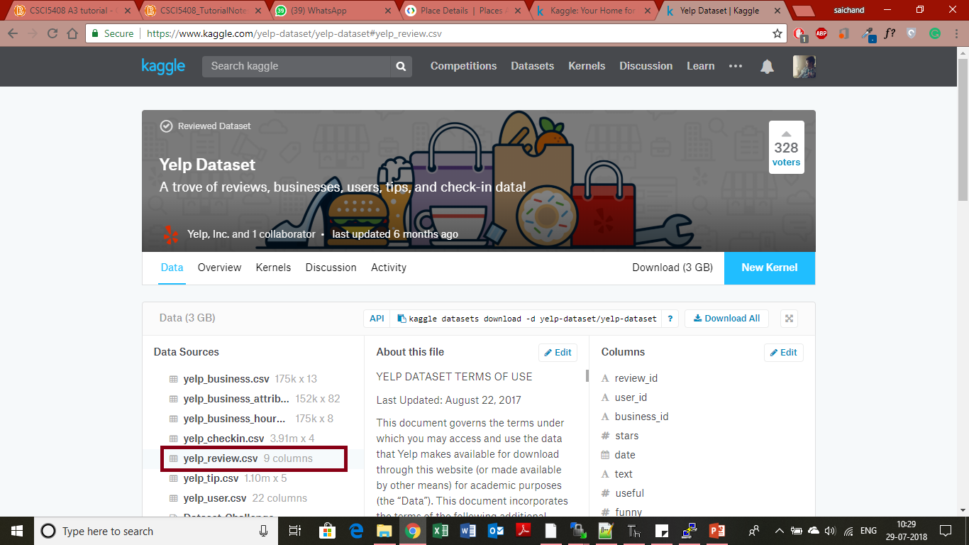
Data Sources

Slide 6
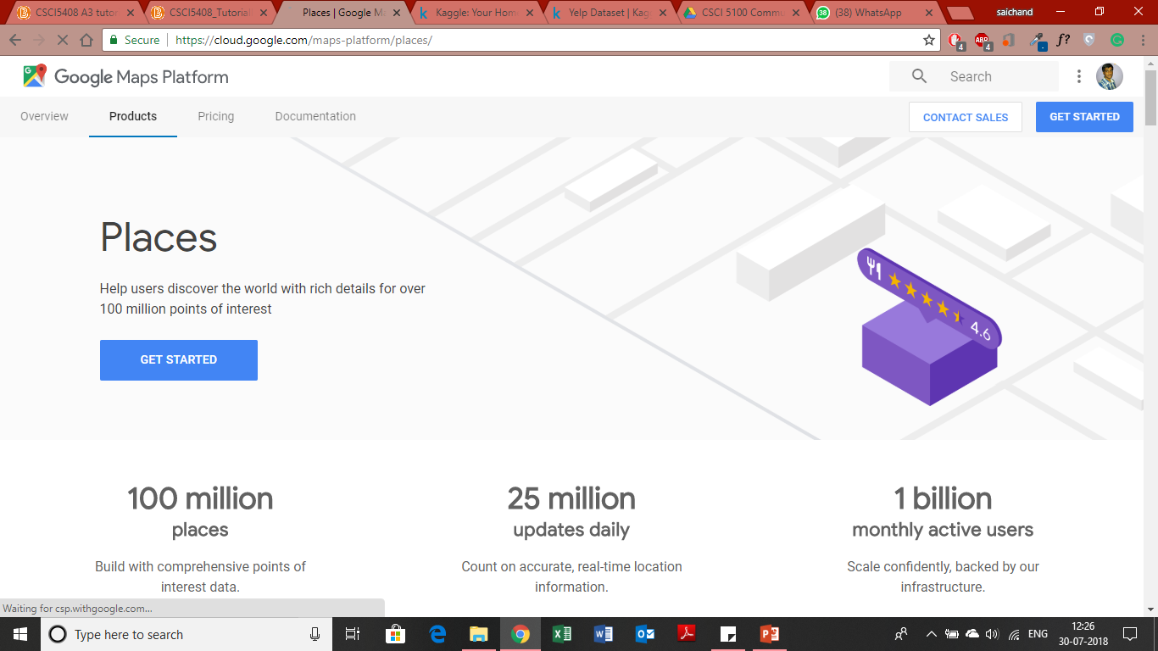
Data Streaming
Google Places API
Google Maps Platform
Places Search API
Place Details API

Slide 7
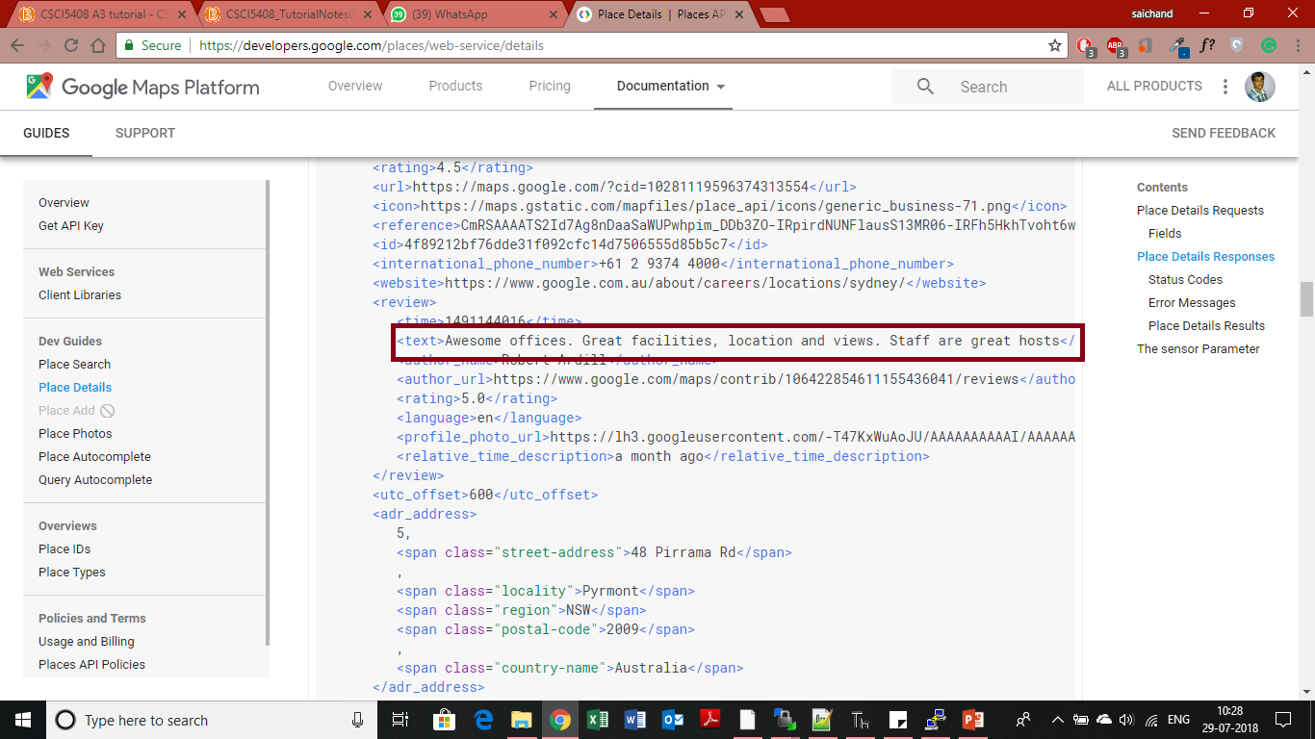

Slide 8
Model training
Yelp review dataset is used for model training
Sentiment analysis on the dataset using Vader Sentiment Library
Data cleaning and Labelling
Training the model using Spark feature extraction & logistic regression classification algorithm

Slide 9
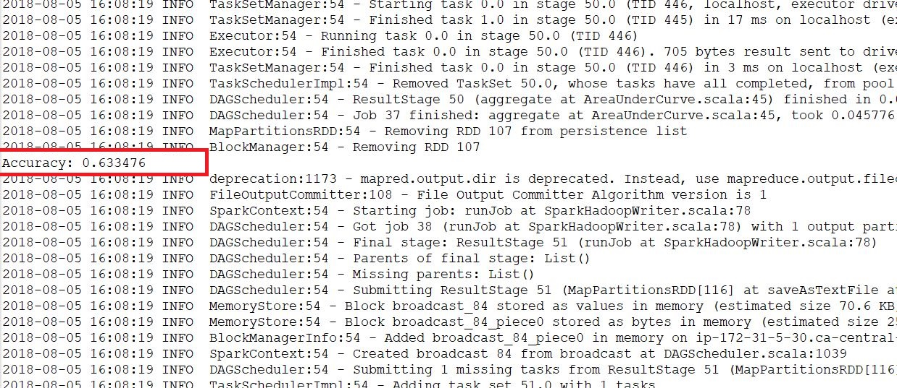
Trained Model - Accuracy

Slide 10
Predictions
Streamed data is loaded into the trained model.
Reviews are classified into three categories like Positive, Negative, Neutral

Slide 11
Tools & algorithm
Python 3.6
Apache Spark
Amazon EC2 instance
Logistic Regression ML classification Algorithm
Vader Sentiment Library
Postman

Slide 12

Future Scope
With Google API Premium access – Large data could be streamed
Train the model with more number of datasets – To improve accuracy
We can come up with a comparison algorithm to compare the ratings & reviews
Possibility for developing a application for the user
Input the Restaurant name
Search different sources and extract the data
Load to the model & predict the score

Slide 13
Conclusion
The Application could provide a one stop solution to customers
It can be extended to the business – Restaurants could analyse the data easily to improve the business

Slide 14
Thank You
Questions ?

